Slide 1

Project Presentation on Face Mask Detection
Presented By :
PALANDE VAIBHAV JAYENDRA (37) Guided By : Prof. Prajakta Pise
PANCHAL KALAPPA PRASAD (38) HOD : PROf. Roshan bauskar
PARAB MANDAR DINESH (39)
Department of Computer Engineering
G.V. Acharya Institute Of Engineering And Technology
Academic Year: 2020-21

Slide 2
INTRODUCTION
Face Mask Detection with Python and Data Procession

Slide 3
Contents
Introduction
Objective
Phases of Face Mask Detector
Face Mask Detection dataset
Classes of dataset
Facial Landmarks & ROI
Future Scope
Conclusion
References

Slide 4
Objective
A model is created using datasets with_mask and without_mask.
Our project is to prepare a data set which would detect whether a person on the camera is wearing a Face Mask or not.

Slide 5
COVID-19: Face Mask Detector
detect face masks most accurately
Detect face masks in real-time video streams

Slide 6
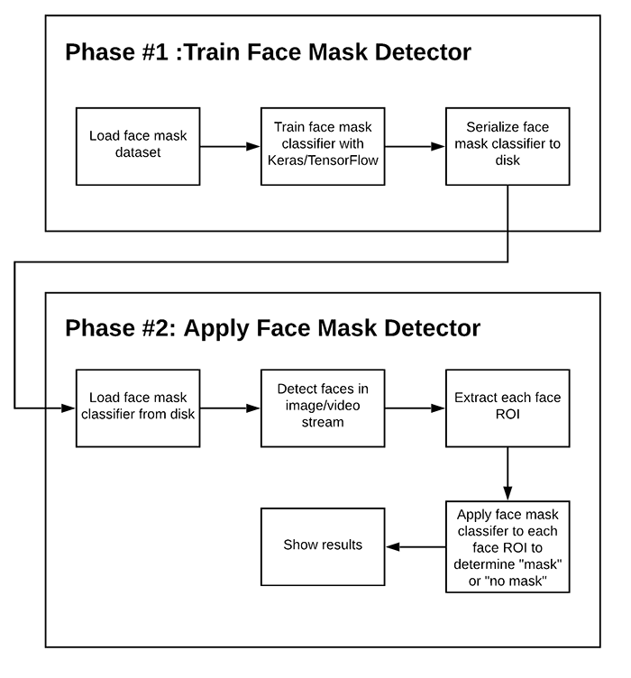
Two-phase COVID-19 face mask detector

Slide 7
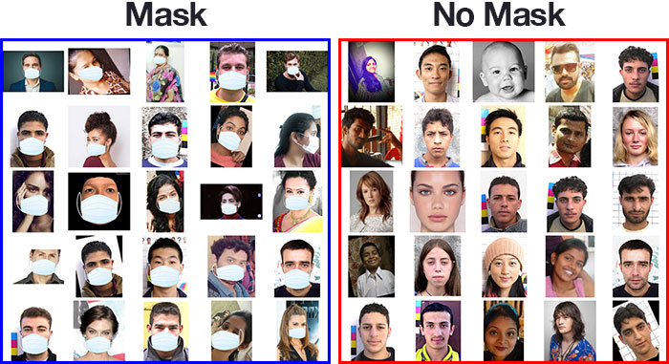
Our COVID-19 face mask detection dataset

Slide 8
This dataset consists of 3,833 images belonging to two classes:
With_mask: 1,915
Without_mask: 1,918

Slide 9
Facial Landmarks
Facial landmarks allow us to automatically infer the location of facial structures, including:
Eyes
Eyebrows
Nose
Mouth
Jawline

Slide 10

To use facial landmarks to build a dataset of faces wearing face masks, we need to first start with an image of a person not wearing a face mask:

Slide 11
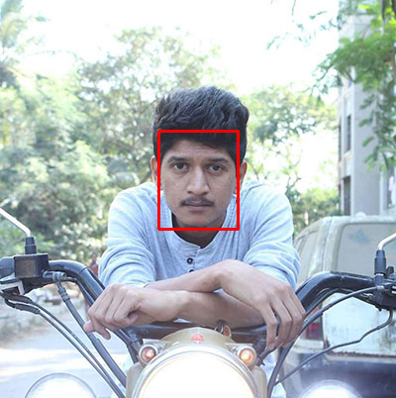
From there, we apply face detection to compute the bounding box location of the face in the image:

Slide 12

Once we know where in the image the face is, we can extract the face Region of Interest (ROI):

Slide 13
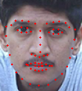
And from there, we apply facial landmarks, allowing us to localize the eyes, nose, mouth, etc.:

Slide 14

Next, we need an image of a mask (with a transparent background) such as the one below:

Slide 15

This mask will be automatically applied to the face by using the facial landmark to compute where the mask will be placed. The mask is then resized and rotated, placing it on the face:

Slide 16
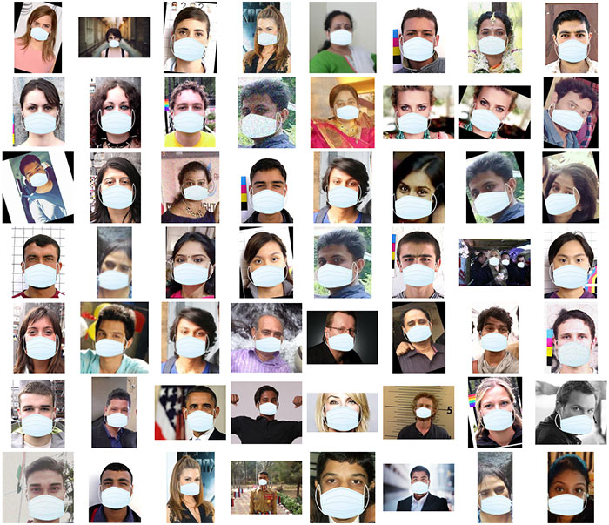
We can then repeat this process for all of our input images, thereby creating our artificial face mask dataset:

Slide 17
Future Scope
In many countries, wearing a mask is compulsory so people have to wear a mask in public places, stores, schools etc. They also like to measures impressions on digital displays.
We can work on our software to use in IP cameras and CCTV cameras to detect people without a mask.
Software operators can also get an notification message or image in case someone is not wearing a mask.
We can also work to implement an alarm system so that someone without a mask enters in area it will beep. It can be connected to entrance gates.

Slide 18
Conclusion
To mitigate the spread of COVID-19 pandemic, measures must be taken. We created a model using the datasets from Kaggle and we developed a Face Mask Detector that detects whether a person on the camera is wearing a Face Mask or not. We trained our Face Mask Detector model using Keras/Tensor flow. From this we can conclude that, our model has the accuracy of 99%.

Slide 19
References
"Face Mask Detection", 2020, [online] Available: Kaggle.com
"Advice on the use of masks in the context of COVID-19: interim guidance", 2020.
M. Jiang, X. Fan and H. Yan, "RetinaMask: A Face Mask detector", 2020, [online] Available: arXiv.org.
"Changing Colorspaces — Opencv-Python Tutorials 1 Documentation", 2020, [online] Available: Opencv-python-tutroals.readthedocs.io.
"Keras documentation: About Keras", 2020, [online] Available: Keras.io.
B. QIN, D. LI, identifying facemask-wearing condition using image super-resolution with classification network to prevent covid-19 (2020)

Slide 20
THANK YOU …

